Slide 1
HR ANALYTICS
-
RASHMI SINGH

Slide 2
Objective
Empowering Organizations: Unleashing the Potential of HR Analytics with Power BI.
In today’s competitive business landscape, organizations are constantly seeking innovative ways to optimize their workforce and drive sustainable growth. One critical aspect of this endeavor is effectively managing human resources, with a particular focus on improving employee performance and retention. To achieve these objectives, Organizations are increasingly turning to data- driven insights provided by HR Analytics tools. Among these, Microsoft Power BI stands out as a powerful platform for visualizing and analyzing HR data, enabling organizations to make informed decisions that positively impact employee engagement and organizational success.
In this project, I will be unraveling the layers of our HR Analytics Dashboard, exploring its features, capabilities, and the transformative impact it has on our business. From deciphering customer behaviors to predicting market trends, this dashboard is the compass guiding our decisions and propelling us towards unprecedented success.
Help an organization to improve employee performance and improve employee retention (reduce attrition) by creating a HR Analytics dashboard.

Slide 3
Objective
Requirements and KPI’s
Real-Time Data Integration
Multi-Channel Integration
User-Friendly Interface
Mobile Responsiveness
Security Measures
Historical Data Analysis
Management
Help an organization to improve employee performance and improve employee retention (reduce attrition) by creating a HR Analytics dashboard.

Slide 4
Objective
Objective
The primary goal of this analytics dashboard is to empower organizations to improve employee organizations to improve employee performance and retention rates by leveraging insightful data analysis. By identifying key factors contributing to attrition and implementing targeted strategies, organizations can enhance their hiring processes, optimize employee experiences, and ultimately foster a more productive workforce.
Help an organization to improve employee performance and improve employee retention (reduce attrition) by creating a HR Analytics dashboard.

Slide 5
Objective
Data Gathering and Import
The first step is gathering relevant data and business requirements.
For this project, I used sample data which is provided in Excel format.
Thereafter, I imported the dataset in Microsoft Power BI for further transformation and analysis.
Help an organization to improve employee performance and improve employee retention (reduce attrition) by creating a HR Analytics dashboard.

Slide 6
Objective
Data Transformation
With the raw data imported, I cleaned and transformed it to prepare for the analysis. Steps involved:
Removed irrelevant columns
Removed duplicate values
Changed the datatypes
Inserted New Conditional Columns
Created DAX measures for calculations. This shows KPI’s like No. of Employees, Attrition, Attrition Rate, Average Age, Average Salary and Average Years.
Help an organization to improve employee performance and improve employee retention (reduce attrition) by creating a HR Analytics dashboard.

Slide 7

Objective
1. Attrition by Gender:
Analyzing attrition patterns based on gender highlights potential disparities in the workplace environment or opportunities that may affect retention rates. Addressing gender-related factors can promote a more inclusive and equitable workplace culture, ultimately contributing to improved retention outcomes.
Insight:
We see that Male Attrition Rate is higher as compared to Females.
Help an organization to improve employee performance and improve employee retention (reduce attrition) by creating a HR Analytics dashboard.

Slide 8
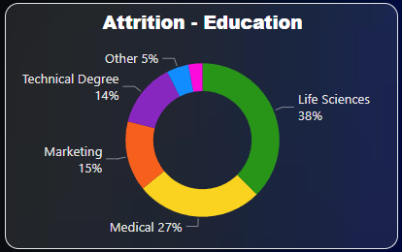
Objective
2. Attrition by Job Education:
Analyzing attrition rates based on education levels provides insights into the impact of educational qualifications on employee retention. This allows for targeted strategies to retain talent and address potential gaps in skill development.
Insight:
This donut- chart provides a breakdown of attrition of employees based on their educational background.
Life Sciences accounted for 38% of Count of Attrition.
Help an organization to improve employee performance and improve employee retention (reduce attrition) by creating a HR Analytics dashboard.

Slide 9
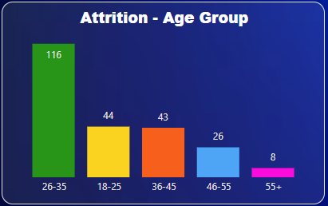
Objective
3. Attrition by Age Group:
Understanding attrition patterns across different age groups sheds light on generational dynamics within the workforce. This insight enables organizations to tailor retention strategies to meet the unique needs and preferences of employees at different stages of their careers.
Insight:
This column chart accounts for Sum of Attrition Count based on their age group.
Between the age group of 26-35 has the highest Sum of Attrition Count i.e 116.
Across all 5 Age Groups, Sum of Attrition Count ranged from 8 to 116.
Help an organization to improve employee performance and improve employee retention (reduce attrition) by creating a HR Analytics dashboard.

Slide 10
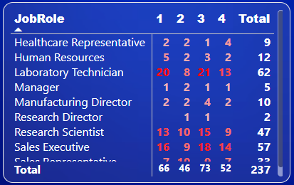
Objective
4. Job Satisfaction Matrix:
This matrix illustrates the rating provided by the employees in their respective job roles.
Insight:
The matrix shows that the employees from Laboratory Technician job role were most unsatisfied with their work as they have the highest number of 1 star rating.
Help an organization to improve employee performance and improve employee retention (reduce attrition) by creating a HR Analytics dashboard.

Slide 11
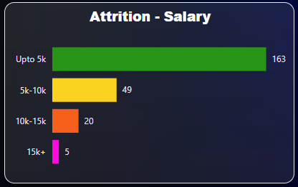
Objective
5. Attrition by Salary:
Examining attrition rates in relation to salary levels helps identify potential disparities in compensation and their impact on employee retention. Addressing issues related to salary competitiveness can contribute to improved employee satisfaction and retention.
Insight:
This column chart provides the information that the sum of Attrition Count is maximum for the people who have salary upto 5k i.e around 163.
Help an organization to improve employee performance and improve employee retention (reduce attrition) by creating a HR Analytics dashboard.

Slide 12
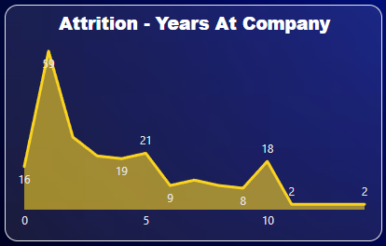
Objective
6. Attrition by Years at Company:
Evaluating attrition rates based on the length of time employee have been with the company provides insights into retention challenges associated with tenure. Understanding why employees leave at different stages of their tenure can inform strategies to enhance engagement and loyalty throughout the employee lifecycle.
Insight:
This line chart illustrates that the employees with 1 year of experience has the highest sum of Attrition Count of 59.
Employees with more than 10 years of experience at company has the least amount of Attrition Count i.e 2.
Help an organization to improve employee performance and improve employee retention (reduce attrition) by creating a HR Analytics dashboard.

Slide 13
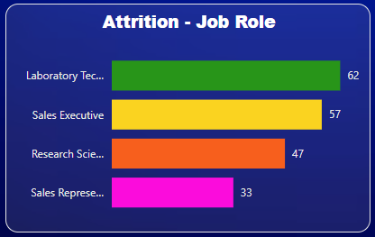
Objective
7. Attrition by Job Role:
Assessing attrition rates by job roles provides valuable insights into the specific challenges and opportunities within different departments or functions. This allows organizations to identify high-risk areas and implement targeted retention initiatives to mitigate talent loss.
Insight:
The column chart shows that the Laboratory Technician has the highest Sum of Attrition count of 62, while the Sales Representative had the lowest Sum of Attrition Count of 33.
Help an organization to improve employee performance and improve employee retention (reduce attrition) by creating a HR Analytics dashboard.

Slide 14
Objective
Conclusion:
In short, looking at data is really crucial for HR Analytics. Figuring out how employees act, their goals, how many leave, and keeping an eye on the company’s big picture helps make smart decisions. This helps them improve plans and stay competitive in the dynamic world.
Help an organization to improve employee performance and improve employee retention (reduce attrition) by creating a HR Analytics dashboard.

Slide 15
Objective
THANK YOU
Help an organization to improve employee performance and improve employee retention (reduce attrition) by creating a HR Analytics dashboard.

